Slide 1

Sentiment Analysis Project On Movie Review
PROJECT & STRATEGY
CONSULTING PROPOSAL
CHANGE MANAGEMENT
IMPLEMENTING CHANGES

Slide 2
- Natural Language Processing (NLP)
is a sub-field of artificial intelligence that deals understanding and processing human language
- Sentiment analysis
is the process of detecting positive or negative sentiment in text. It’s often used by businesses to detect sentiment in social data, gauge brand reputation, and understand customers

Slide 3
IMDB Internet Movie Database
In this notebook, we’ll use an IMDB dataset of 50k movie reviews available on Kaggle. The dataset contains 2 columns (review and sentiment) that will help us identify whether a review is positive or negative.
Problem formulation: Our goal is to find which machine learning model is best suited to predict sentiment (output) given a movie review (input).
labeled as positive or negative No more than 30 reviews are included per movie.

Slide 4
CONTENTS OF THIS PRESENTATION
PROJECT & STRATEGY
CONSULTING PROPOSAL
CHANGE MANAGEMENT
IMPLEMENTING CHANGES
Read the Data
Exploratory Data Analysis EDA
Preprocessing and cleaning the text data
Data Visualization
Tokenization
Normalizing Words
Preparing the text for training
feature extraction (TF-IDF)
Split into train and test sets
Implementing the models
Finding the best model

Slide 5


Slide 6

01
Read the Data
PROJECT & STRATEGY
CONSULTING PROPOSAL
CHANGE MANAGEMENT
IMPLEMENTING CHANGES

Slide 7
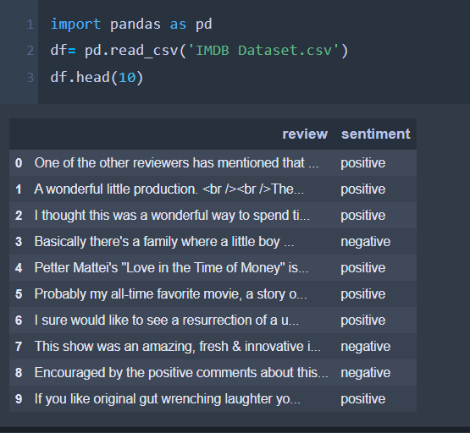
PROJECT & STRATEGY
CONSULTING PROPOSAL
CHANGE MANAGEMENT
IMPLEMENTING CHANGES
We noticed that we had several problems with the text
labeled as positive or negative

Slide 8

02
Exploratory Data Analysis EDA
PROJECT & STRATEGY
CONSULTING PROPOSAL
CHANGE MANAGEMENT
IMPLEMENTING CHANGES

Slide 9
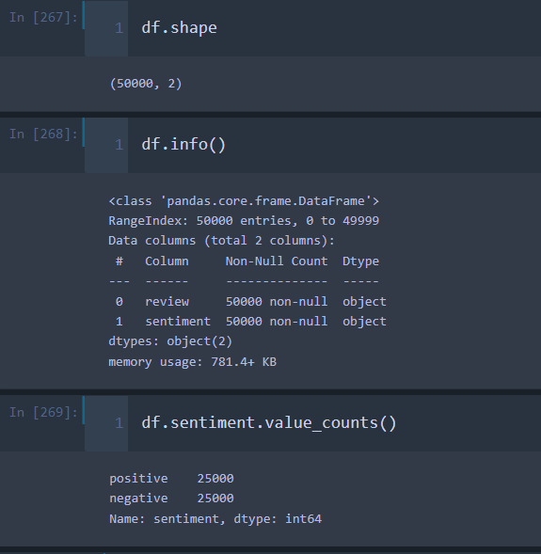
EDA

Slide 10
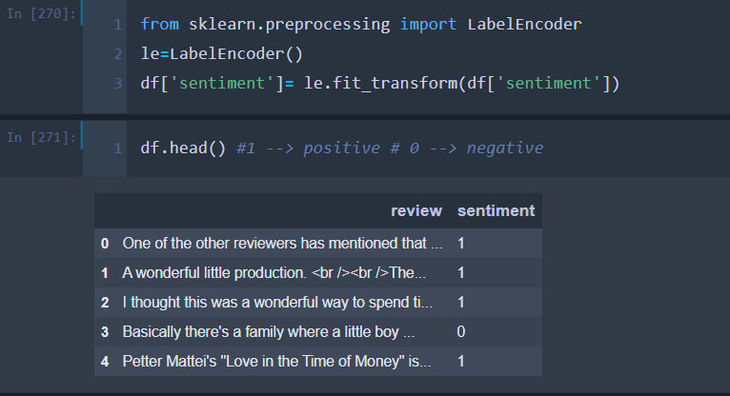
Update sentiment (sentiment encoding) Right now the sentiment column is negative for negative, positive for positive. Let's change that to 0 and 1 to make things a little more reasonably readable.

Slide 11
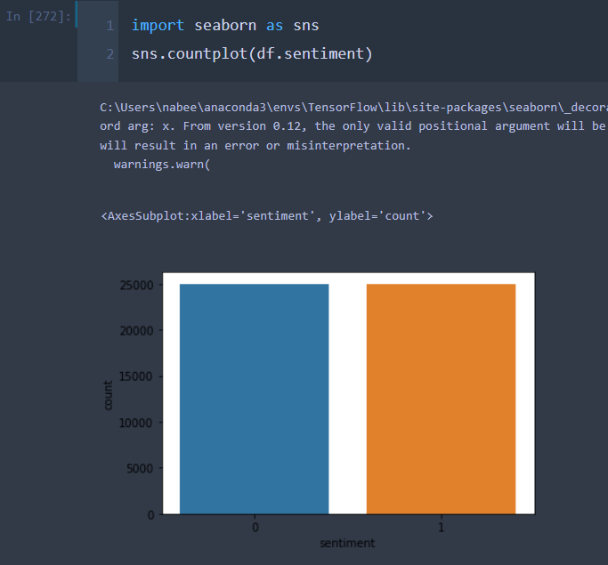
We can see that the dataset is balanced.
A balanced dataset is a dataset where each output class (or target class) is represented by the same number of input samples
Imbalanced data refers to those types of datasets where the target class has an uneven distribution of observations, i.e one class label has a very high number of observations and the other has a very low number of observations

Slide 12
03
Preprocessing and cleaning the text data
PROJECT & STRATEGY
CONSULTING PROPOSAL
CHANGE MANAGEMENT
IMPLEMENTING CHANGES

Slide 13
What are Stop words?
Stop Words: A stop word is a commonly used word (such as “the”, “a”, “an”, “in”) that a search engine has been programmed to ignore, we remove the low-level information from our text in order to give more focus to the important information
Movie review: “The movie was not good at all.”
Text after removal of stop words: “movie good”
We can clearly see that the review for the movie was negative. However, after the removal of stop words, the review became positive, which is not the reality. Thus, the removal of stop words can be problematic here.
so we will keep the not : "movie not good"

Slide 14
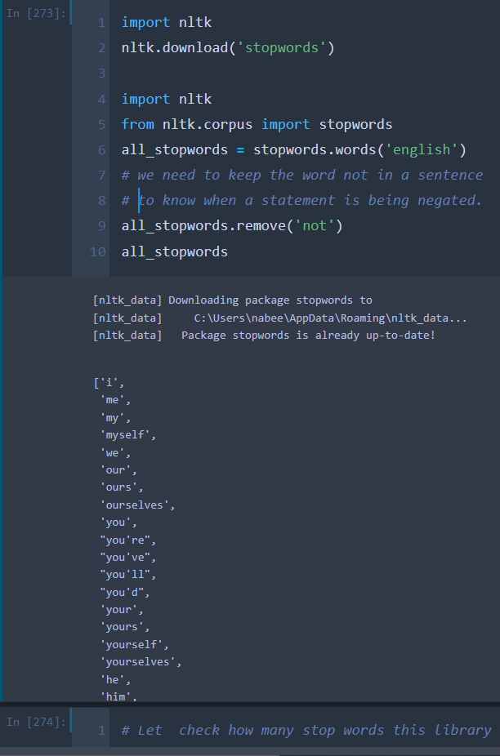
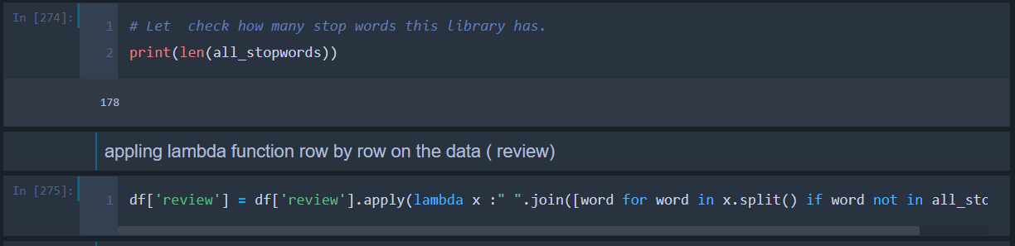
Dealing with stop words

Slide 15
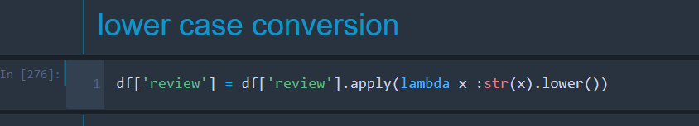
Lower case
converting all the text into lower case because the model might treat a word which is in the beginning of a sentence with a capital letter different from the same word which appears later in the sentence but without any capital latter.

Slide 16
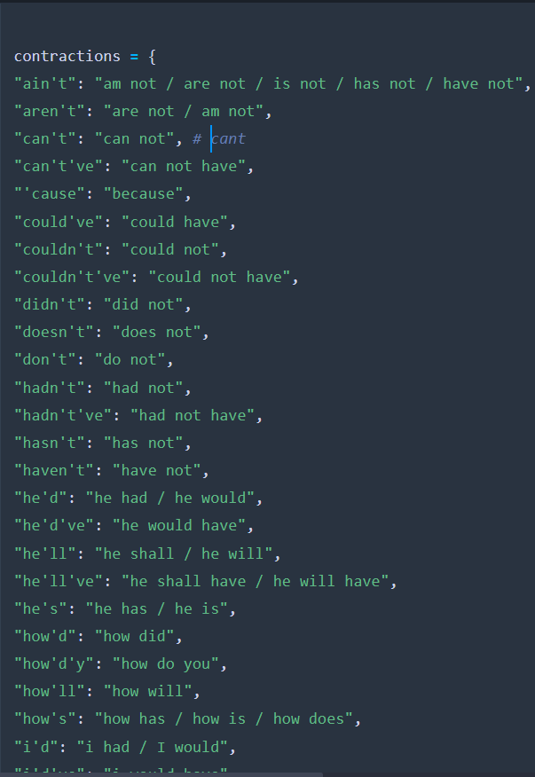
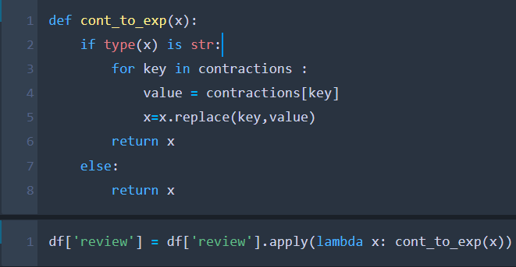
contraction to expansion
Contractions are words or combinations of words that are shortened by dropping letters and replacing them by an apostrophe.
on reviews of a product as the words play an important role in sentiment analysis.
- 120 word

Slide 17
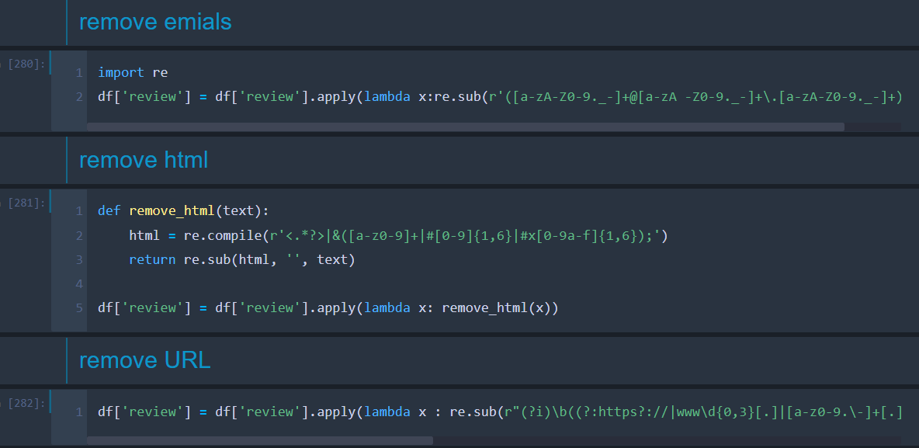
Cleaning the text 1

Slide 18
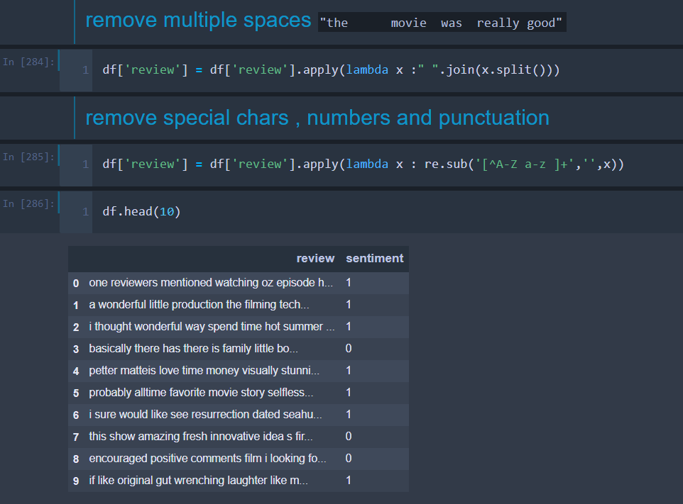
Cleaning the text 2

Slide 19
04
Data Visualization
PROJECT & STRATEGY
CONSULTING PROPOSAL
CHANGE MANAGEMENT
IMPLEMENTING CHANGES

Slide 20
Word Cloud
Word Cloud is a data visualization technique used for representing text data in which the size of each word indicates its frequency or importance. Significant textual data points can be highlighted using a word cloud.

Slide 21
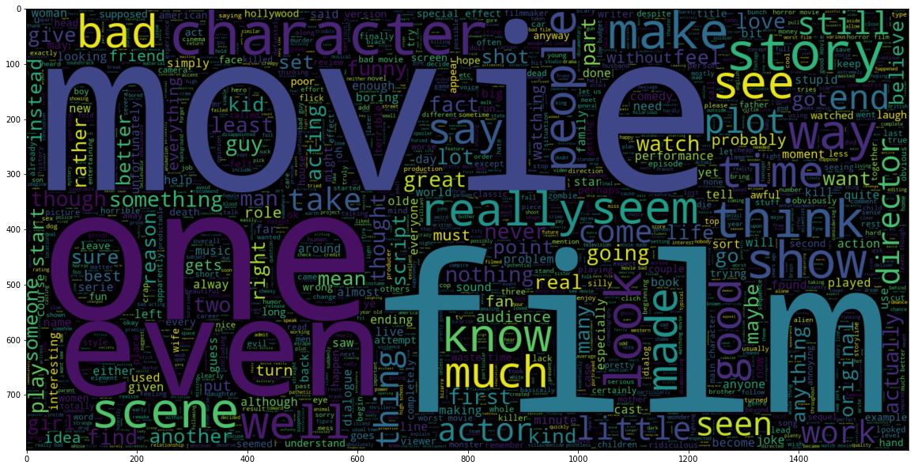
sentiment == 0 (Negative)

Slide 22
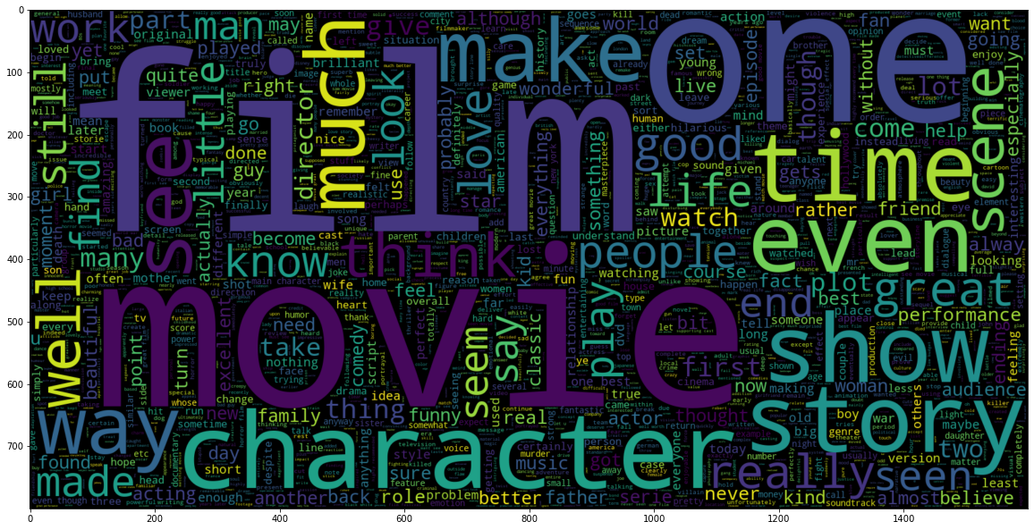
sentiment == 1 (positive)

Slide 23
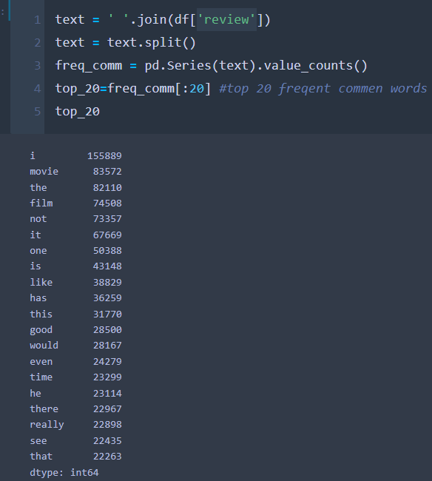
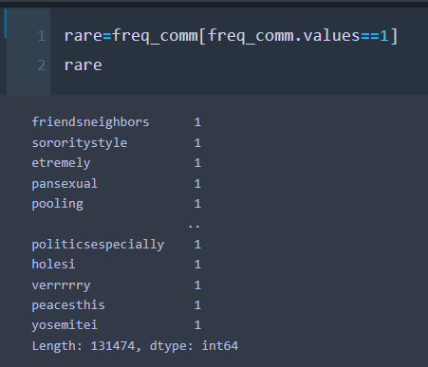
frequent words
rare words

Slide 24
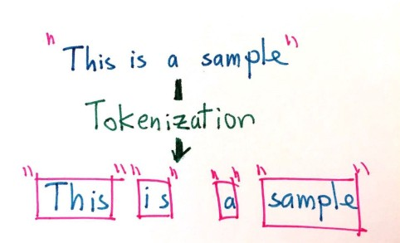
The first part of making sense of the data is through a process called tokenization, or splitting strings into smaller parts called tokens. It is a particular kind of document segmentation. It does breaks up text into smaller chunks or segments called tokens. A tokenizer breaks unstructured data, natural language text, into chunks of information that can be counted as discrete elements. After this operation these counts of token occurrences in particular document can be used as a vector representing given document.
Tokenization

Slide 25
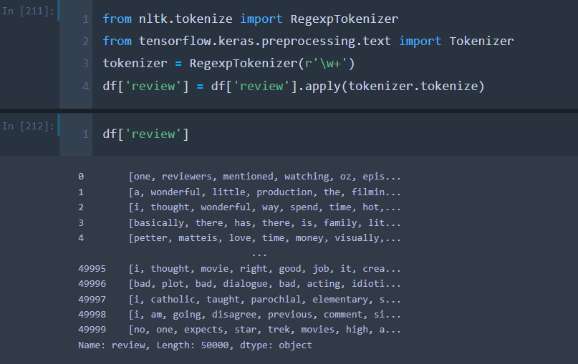
Applying the Tokenization

Slide 26
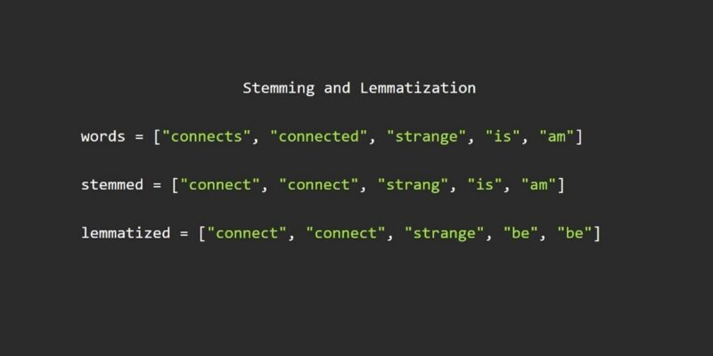
Normalizing Words
For grammatical reasons, documents are going to use different forms of a word, such as write, writing and writes. Additionally, there are families of derivationally related words with similar meanings. The goal of both stemming and lemmatization is to reduce inflectional forms and sometimes derivationally related forms of a word to a common base form.
convert to the base form --> is required because vocabulary library will be varied large Convert into base or root of word.

Slide 27
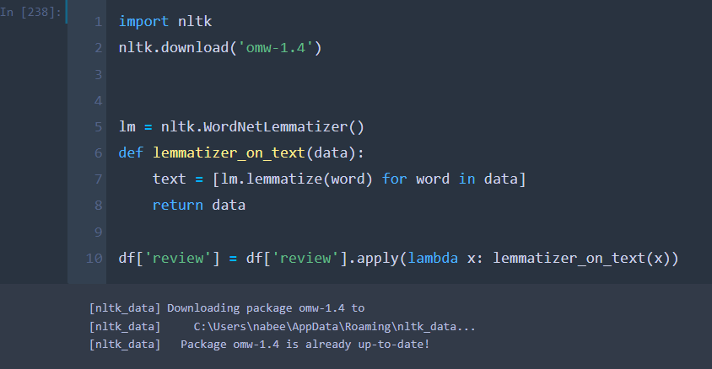
Applying Lemmatizer

Slide 28
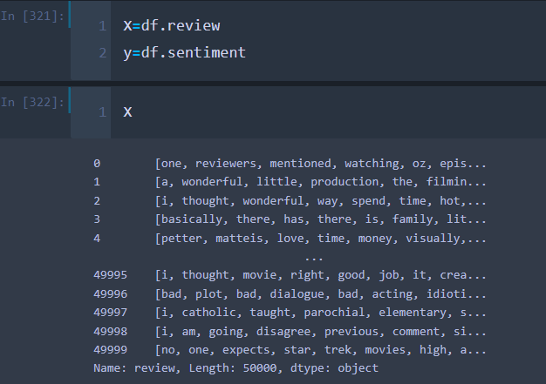
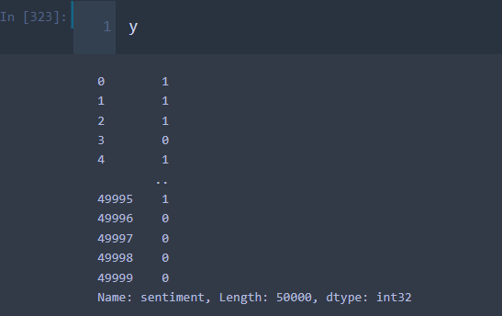
Separating text and label

Slide 29

05
Preparing the text for training
PROJECT & STRATEGY
CONSULTING PROPOSAL
CHANGE MANAGEMENT
IMPLEMENTING CHANGES

Slide 30
feature extraction Term Frequency-Inverse Document Frequency model (TFIDF)
- Machine learning algorithms cannot work with raw text directly. Rather, the text must be converted into vectors of numbers
- term frequency is simply the ratio of the count of a word present in a sentence, to the length of the sentence
TF-IDF use two statistical methods, first is Term Frequency and the other is Inverse Document Frequency. Term frequency refers to the total number of times a given term t appears in the document doc against (per) the total number of all words in the document and The inverse document frequency measure of how much information the word provides. It measures the weight of a given word in the entire document. IDF show how common or rare a given word is across all documents. TF-IDF can be computed as tf * idf
- The idea is to assign particular weights to words that tell us about how important they are in the document.

Slide 31
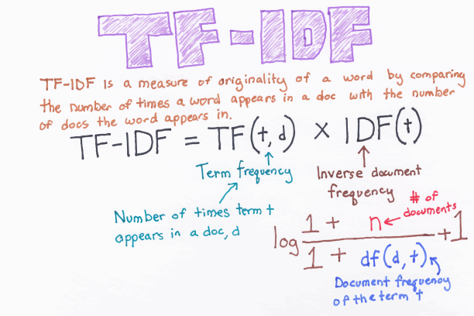
TF-IDF

Slide 32
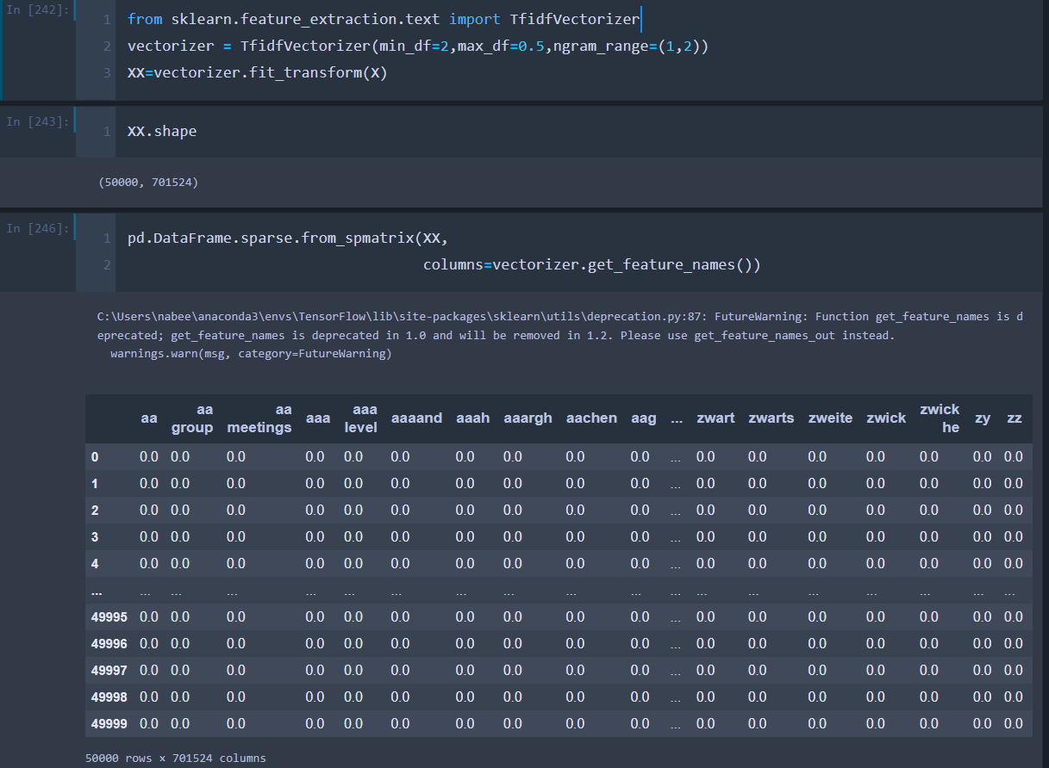
Applying the TF-IDF

Slide 33
TF-IDF
Max_df is used for removing terms that appear too frequently , also known as corpus-specific stop words
Max_df=0.50 means ignore terms that appear in more than 50% of the document
Min_df is used for removing terms that appear too infrequently
Mid_df = 2 means ignore terms that appears in less than 2 documents
ngram_range: An n-gram is just a string of n words in a row. . Set the parameter ngram_range=(a,b) where a is the minimum and b is the maximum size of ngrams you want to include in your features. I found that including 2-grams as features boosted my model’s predictive power significantly.

Slide 34
splitting the data
As we prepared all the review, now we are separating/splitting the reviews into training data and testing data. 80% tweets will be used in the training 20% tweets will be used to test the performance of the model.
Training Data
We use training data when we train the models. We feed train data to machine learning and deep learning models so that model can learn from the data.
Testing Data
We use testing data after training the model. We use this data to evaluate the performance that how the model perform after training. So in this way first we get predictions from the trained model without giving the labels and then we compare the true labels with predictions and get the performance of the model..

Slide 35
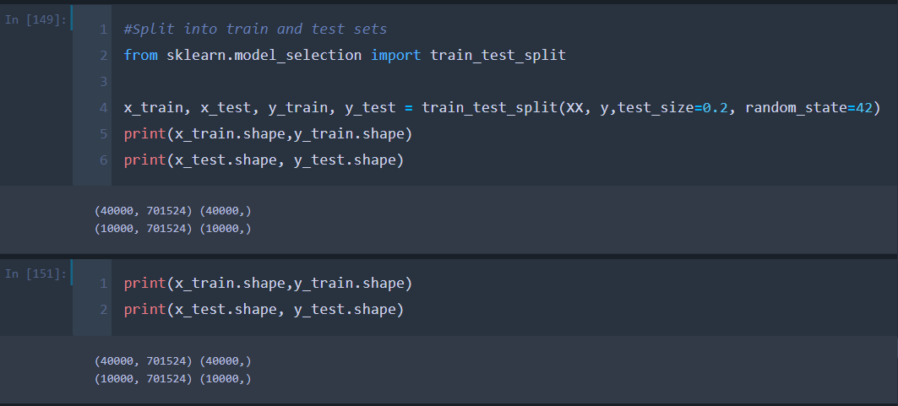
Split into train and test sets

Slide 36
06
Implementing the models In our example, our input (review) and output (sentiment) are clearly identified, so we can say we have labeled input and output data; therefore, we’re dealing with supervised learning.
PROJECT & STRATEGY
CONSULTING PROPOSAL
CHANGE MANAGEMENT
IMPLEMENTING CHANGES

Slide 37
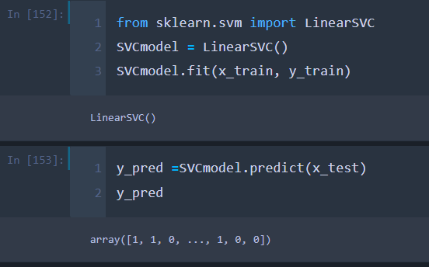

Support vector machines (SVMs)

Slide 38
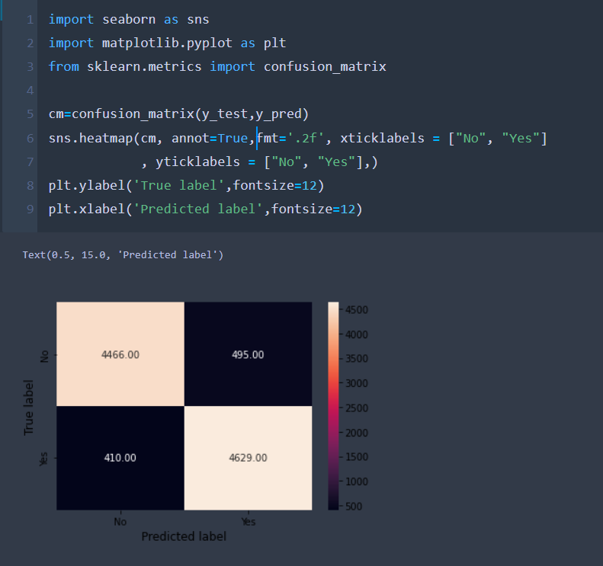
Confusion matrix

Slide 39
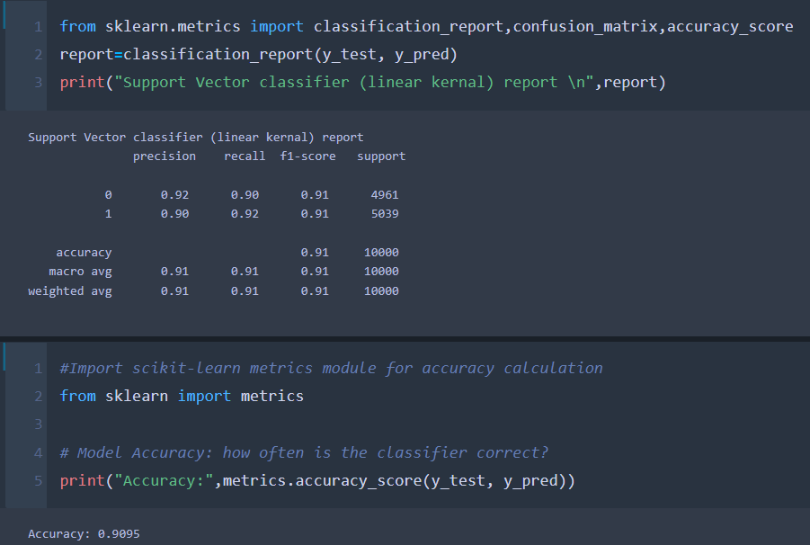
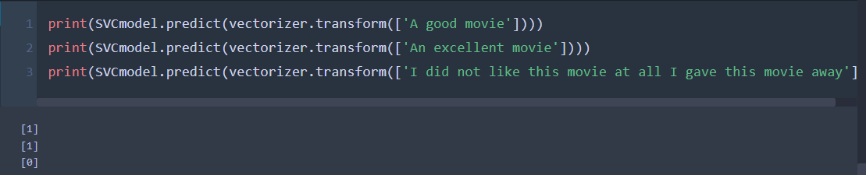
Model accuracy
The model support vector machine accuracy is 90.95%

Slide 40
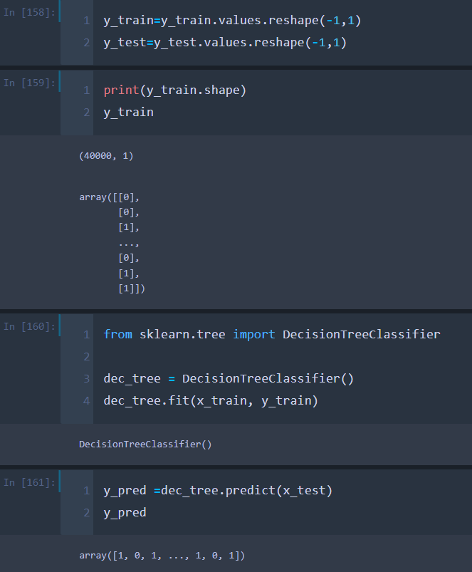
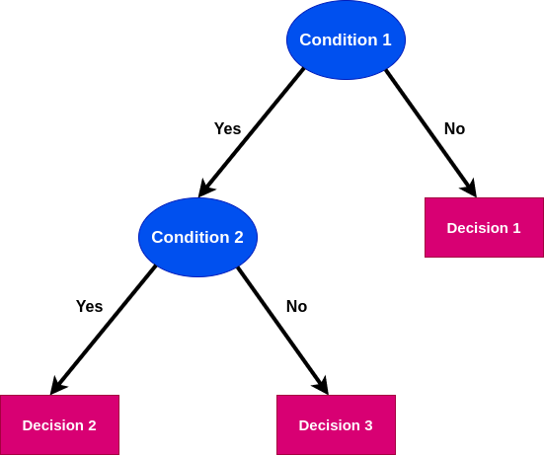
Decision Tree
A decision tree is a graphical representation of all possible solutions to a decision based on certain conditions

Slide 41
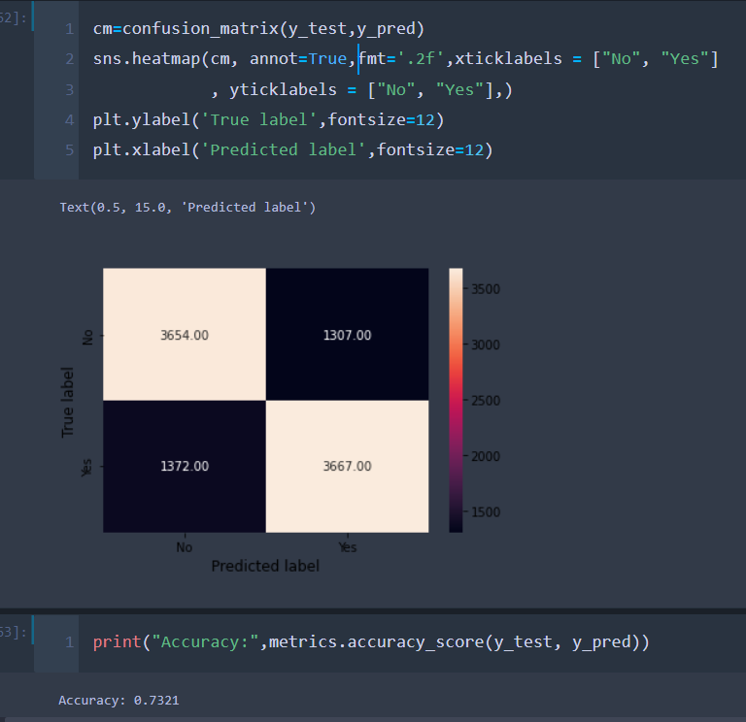
The model Decision tree accuracy is 73.21%

Slide 42
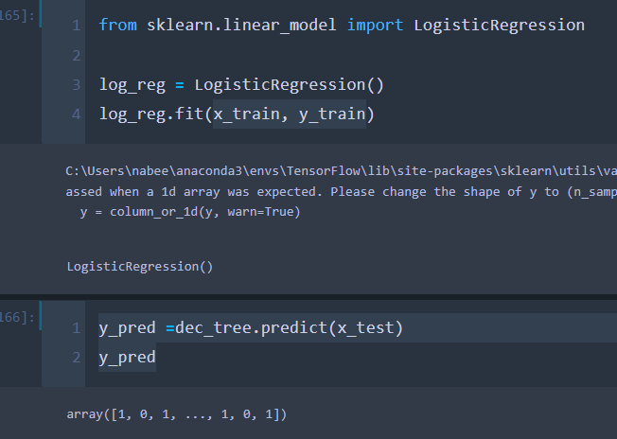

Logistic Regression
Sigmoid Function: The sigmoid function is useful to map any predicted values of probabilities into another value between 0 and 1.

Slide 43
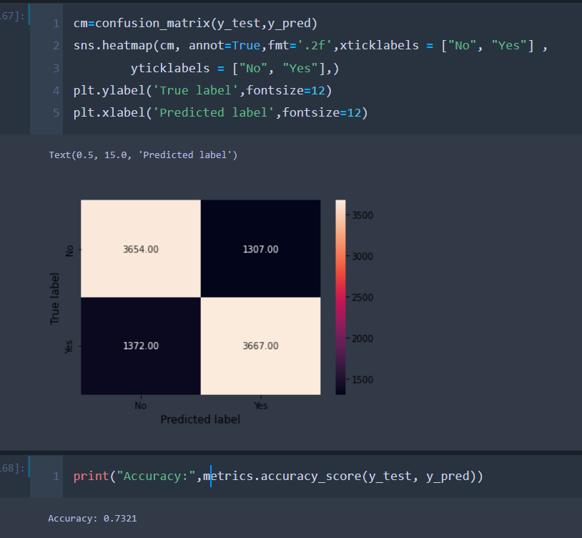
The model Logistic Regression accuracy is 73.21%

Slide 44
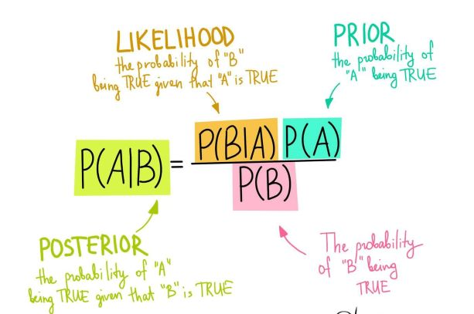
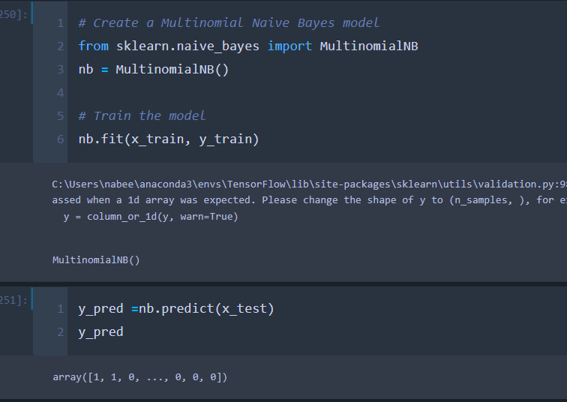
Naive Bayes model
Naive Bayes are mostly used in natural language processing (NLP) problems. Naive Bayes predict the tag of a text. They calculate the probability of each tag for a given text and then output the tag with the highest one.

Slide 45
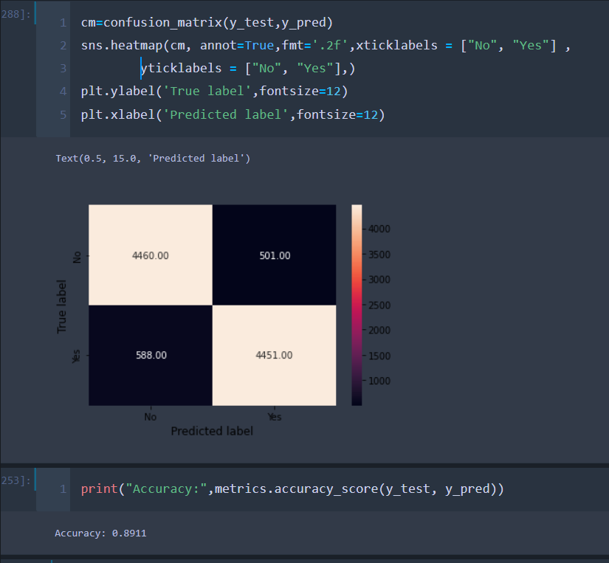
The model Naive Bayes accuracy is 89.11%

Slide 46

Accuracy model TABLE
PROJECT & STRATEGY
CONSULTING PROPOSAL
CHANGE MANAGEMENT
IMPLEMENTING CHANGES
The models | Accuracy
Support vector machines | 90.95%
Decision tree | 73.21%
Logistic Regression | 73.21%
Naive Bayes | 89.11%
-- | --

Slide 47



THANKS !
PROJECT & STRATEGY
CONSULTING PROPOSAL
CHANGE MANAGEMENT
IMPLEMENTING CHANGES
Rama AlMarahlh

